Slide 1
Evaluation Metrices for Natural Language Processing Models

Slide 2
Introduction
To assess the performance of NLP models and compare them to make informed decisions.
MRR
MAP
BLEU Score
ROUGE Score

Slide 3
Information Retrieval Model
A retrieval model (IR) chooses and ranks relevant pages based on a user's query.
Document selection and ranking can be formalized using matching functions that return retrieval status values (RSVs) for each document in a collection.
The query-document matching function in an IR model
The estimation of the likelihood of user relevance for each page and query in relation to a collection of q training documents.
In a vector space, the similarity function between queries and documents is computed.
It is a software program that deals with organization, storage, retrieval, and evaluation of information from documents repository particularly textual information.

Slide 4
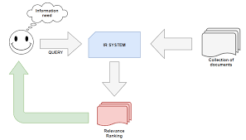
Information Retrieval Model..

Slide 5
Components of Information Retrieval/ IR Model
Acquisition
Documents and other things are being chosen from various websites.
Documents that are mostly text-based or entire texts, titles, abstracts
Other research-based objects like Data, statistics, photos, maps, copyrights, soundscapes, and so on...
Web crawlers take data and store it in a database.

Slide 6
Components of Information Retrieval/ IR Model..
Representation
The representation of information retrieval system mainly involves indexing the following:
Indexing may be done in a variety of methods, including free text keywords (even in entire texts) or regulated vocabulary - thesaurus or manual and automatic procedures.
Summarizing and abstracting
Bibliographic information: author, title, sources, date, etc.
Information about metadata
Classification and clustering
Field and limit organization
Basic Index, Supplemental Index Limits

Slide 7
Components of Information Retrieval/ IR Model…
File Organisation
There are mainly 2 categories of file organization which are: sequential and inverted.
Sequential
It organizes documents based on document data.
Reversed
It provides a list of records under each phrase, term by term.
Combination
Combination of inverted indexes as well as sequential documents

Slide 8
Components of Information Retrieval/ IR Model…
Query
When a user inputs a query into the system, an IR process begins.
Queries, such as search strings in web search engines, are explicit representations of information requests.
A query in information retrieval system does not uniquely identify a particular object in a collection.
Instead, numerous things may match the query, maybe with varying degrees of significance.

Slide 9
Information Retrieval Vs Data Retrieval
Data retrieval (a database management system or DBMS) works with structured data with well-defined semantics, whereas IR deals with unstructured/semi-structured data.
When a DBMS system is queried, it returns exact/precise results or no results if no exact match is discovered. In contrast, querying an IR system yields several results with ranking.

Slide 10
Types of Information Retrieval Models
Classic IR Model:most basic and straightforward IR model and founded on mathematical information: Boolean, Vector, and Probabilistic.
Non-Classic IR Model:Addition than probability, similarity, and Boolean operations, such IR models are based on other ideas. situation theory models, information logic models, and interaction models etc.
Alternative IR Model: improvement to the traditional IR model that makes use of some unique approaches from other domains. Alternative IR models include fuzzy models, cluster models, and latent semantic indexing (LSI) models.

Slide 11
MRR[Mean Reciprocal Rank]
It is a ranking quality metric.
It returns the rank list of answer to query.
It considers the position of the first relevant item in the ranked list.
We compute mean of Reciprocal Ranks across all users or queries.
A Reciprocal Rank of query response is the multiplicative inverse of first correct answer.
You get 1 for first place, 1⁄2 for second place, 1⁄3 for third place and so on. If there is no relevant item or correct answer in top-K, the reciprocal rank is 0.
MRR values range from 0 to 1, where "1" indicates that the first relevant item is always at the top.
Higher MRR means better system performance.
metrics that help evaluate the quality of recommendation and information retrieval systems.

Slide 12
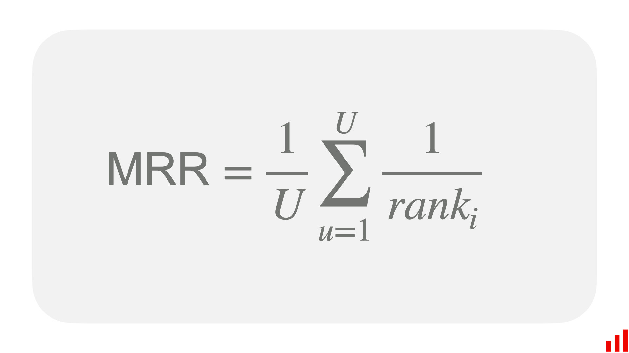
Mean Reciprocal Rank (MRR) at K evaluates how quickly a ranking system can show the first relevant item in the top-K results.
Where:
U is the total number of users (in case of recommendations) or queries (in case of information retrieval) in the evaluated dataset.
Rank i is the position of the first relevant item for user u in the top-K results.

Slide 13
Example
Suppose three sample queries for a system that tries to translate English word to their plurals. In each case the system makes three guesses, with the first one being the one it thinks is most likely correct.
Query | Proposed Result | Correct Response | Rank | Reciprocal Rank
Cat | Catten, Cati, Cats | Cats | 3 | 1/3
Virus | Viruses, Virit, Viti | Viruses | 1 | 1
MRR =1/2*(1/3 +1) =.67

Slide 14
If none of the proposed result correct , reciprocal rank is zero.
Only the rank of first relevant answer is considered and further relevant items are ignored.
For further relevant items, Mean Average Precision is an alternative metric.

Slide 15

Mean Average Precision (MAP)
It is a metric used to measure the performance of a model for tasks such as object detection tasks and information retrieval.
It Leverages these sub-metrics: Confused Matrix, Intersection over Union(IoU), Recall, and Precision.
It calculates the mean precision across each retrieved result.
MAP for a set of queries is the mean of average precision score for each query.
where Q is the number of queries in the set and AveP(q) is the average precision (AP) for a given query, q.
Precision @K:
By default, precision takes all the retrieved documents into account, but however, it can also be evaluated at a given number of retrieved documents, commonly known as cut-off rank, where the model is only assessed by considering only its top-most queries.
The measure is called precision at k or P@K.

Slide 16
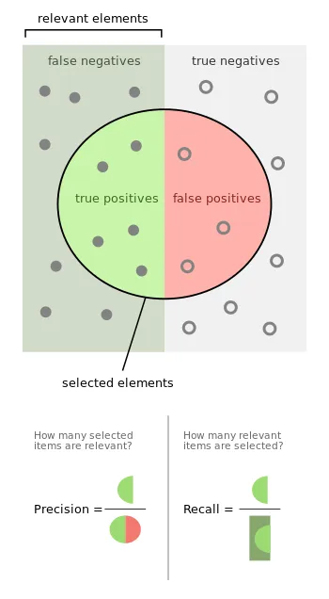


$$FallOut=\frac{|\left\{Non_{relevent}Document \right\}|∪|\left\{Retrieved Document\right\}|}{|\left\{Non_{relevent}Document\right\}|}$$

Slide 17
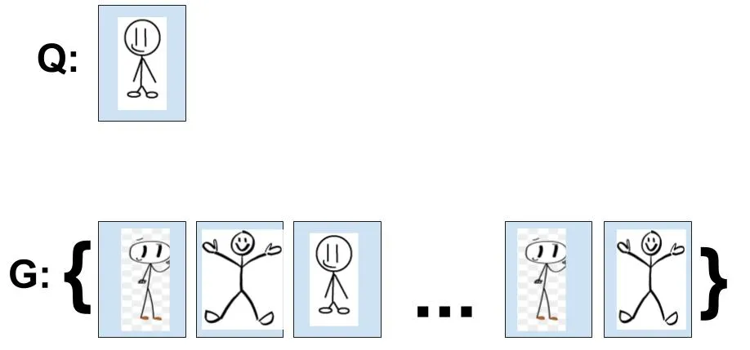
Example
Q to be the user query
G to be a set of labeled data in the database
d(i,j) to be a score function to show how similar object i is to j
G’ which an ordered set of G according to score function d( , )
k to be the index of G’
User querying G with a document Q

Slide 18

After calculating the d( , ) for each of the documents with Q, we can sort G and get G’. Say the model returns the following G’
Using the Precision formula above, we get the following,
P@1 = 1/1 = 1
P@2 = 1/2 = 0.5
P@3 = 1/3 = 0.33
P@4 = 2/4 = 0.5
P@5 = 3/5 = 0.6
P@n = 3/n

Slide 19

Average Precision and MAP for Information Retrieval
After computing Precision@k, we can now move on to calculate the Average Precision.
This would give us a better measurement of our model in its ability to sorting the results of the query, G’.
where GTP refers to the total number of ground truth positives, n refers to the total number of documents you are interested in, P@k refers to the precision@k and rel@k is a relevance function.
The relevance function is an indicator function which equals 1 if the document at rank k is relevant and equals to 0 otherwise.

Slide 20
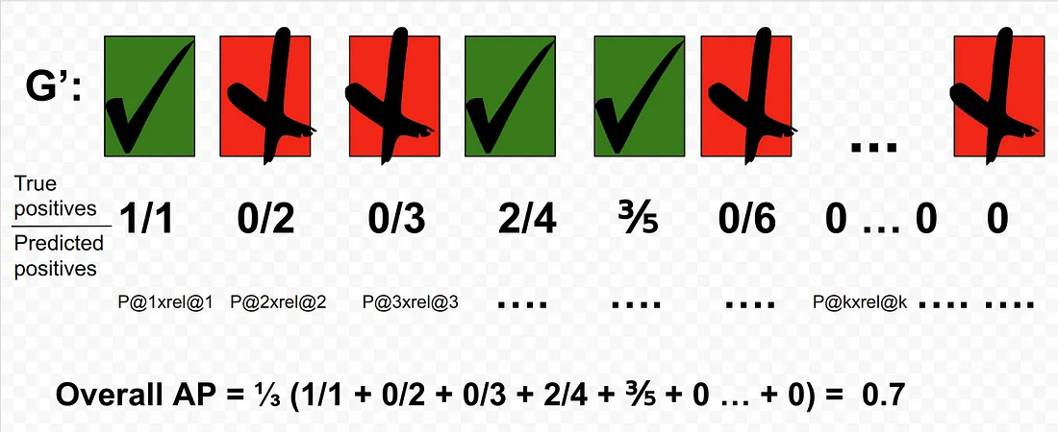
The overall AP for this query is 0.7.
One thing to note is that since we know that there are only three GTP, the AP@5 would equal to overall AP.

Slide 21
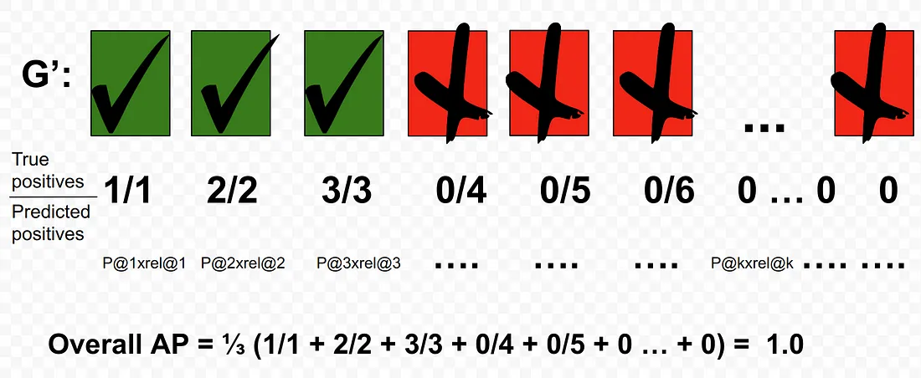
For another query, Q, we could get a perfect AP of 1 if the returned G’ is sorted as such:

Slide 22

Computation of MAP
For each query, Q, we can calculate a corresponding AP.
A user can have as much queries as he/she likes against this labeled database.
The mAP is simply the mean of all the queries that the use made.
Suppose there are 5 queries then
MAP = 1/5[0.7+.3+0.8+1.0+1.0] =0.76

Slide 23
Bilingual Evaluation Understudy[BLEU] Score
Widely used in Machine Translation Task.
Used to evaluate automatically translate text from one language to another.
It is used to assess the quality of machine-generated translations by comparing them to a set of reference translations provided by human translators.
It measures the similarity between the machine-translated text and the reference translations using n-grams, which are contiguous sequences of n words.
Commonly used n-grams are unigrams (single words), bigrams (two-word sequences), trigrams (three-word sequences), and so on.
BLEU score ranges from 0 to 1, with higher values indicating better translation quality.

Slide 24
Bilingual Evaluation Understudy[BLEU] Score..
Precision:
We count each of the n-gram in the MT sentence whether it has shown in any of the reference sentences, gather the total counts for each of the unique n-gram, sum up the total counts for each of the unique ngram, and divided by the number of n-grams in the MT sentence.

Slide 25
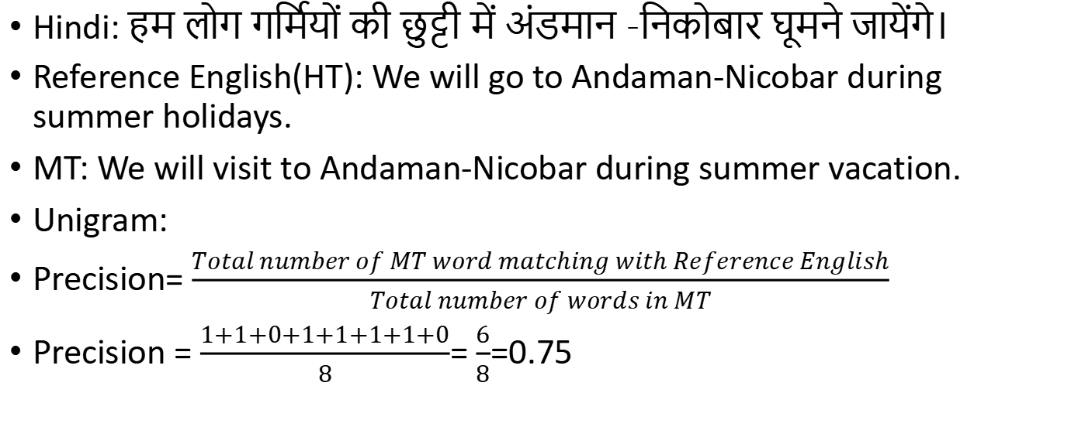
Example (Hindi to English)
Hindi: हम लोग गर्मियों की छुट्टी में अंडमान -निकोबार घूमने जायेंगे।
Reference English(HT): We will go to Andaman-Nicobar during summer holidays.
MT: We will visit to Andaman-Nicobar during summer vacation.
Unigram:
Precision= $\frac{Total number of MT word matching with Reference English}{Total number of words in MT}$
Precision = $\frac{1+1+0+1+1+1+1+0}{8}$= $\frac{6}{8}$=0.75

Slide 26
Unigram | Shown?
We | 1
will | 1
visit | 0
to | 1
Andaman-Nicobar | 1
during | 1
summer | 1
vacation | 0

Slide 27
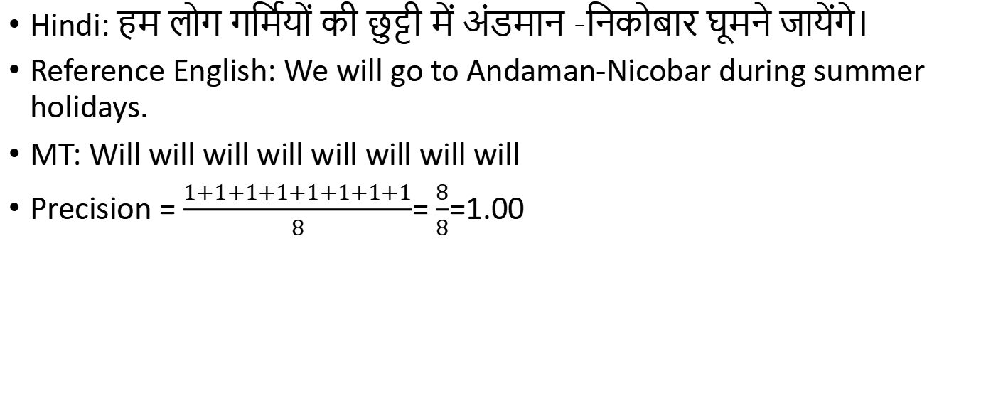
Hindi: हम लोग गर्मियों की छुट्टी में अंडमान -निकोबार घूमने जायेंगे।
Reference English: We will go to Andaman-Nicobar during summer holidays.
MT: Will will will will will will will will
Precision = $\frac{1+1+1+1+1+1+1+1}{8}$= $\frac{8}{8}$=1.00

Slide 28
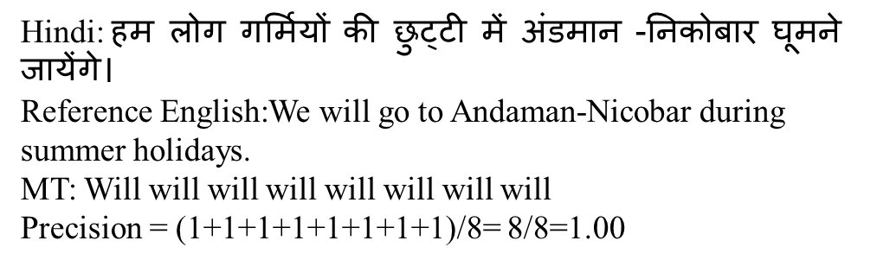
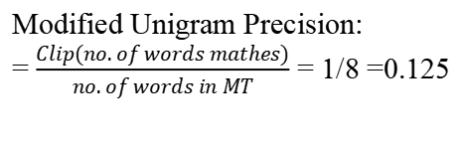
Modified BLEU Score
Modified Precision(Unigram):
Proposed for better scoring blocks of multiple sentences
For each unique ngram, we count its maximum frequency in each of the reference sentences. The minimum of this special count and the original count is called the clipped the count.
the clipped count is no greater than the original count.
We then use this clipped count, in place of the original count, for computing the modified precision.
Modified Unigram Precision:
= $\frac{Clip(no. of words mathes)}{no. of words in MT}$ = 1/8 =0.125

Slide 29
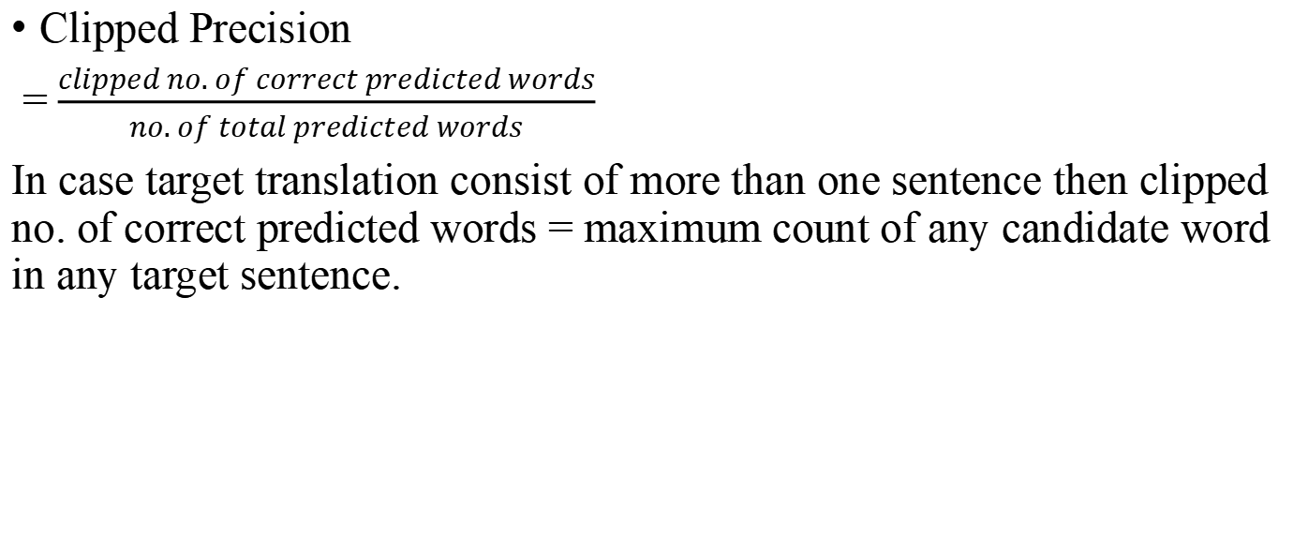
Clipped Precision
= $\frac{clipped no. of correct predicted words}{no. of total predicted words}$
In case target translation consist of more than one sentence then clipped no. of correct predicted words = maximum count of any candidate word in any target sentence.

Slide 30
Example
Unique Unigram | Count | Clipped Count
the | 3 | 2
cat | 2 | 1
on | 1 | 1
mat | 1 | 1
Reference 1: the cat is on the mat
Candidate[MT]: the cat the cat on the mat
Unique Bigram | Count | Clipped Count
the cat | 2 | 1
cat the | 0 | 0
cat on | 1 | 1
on the | 1 | 1
the mat | 1 | 1

Slide 31
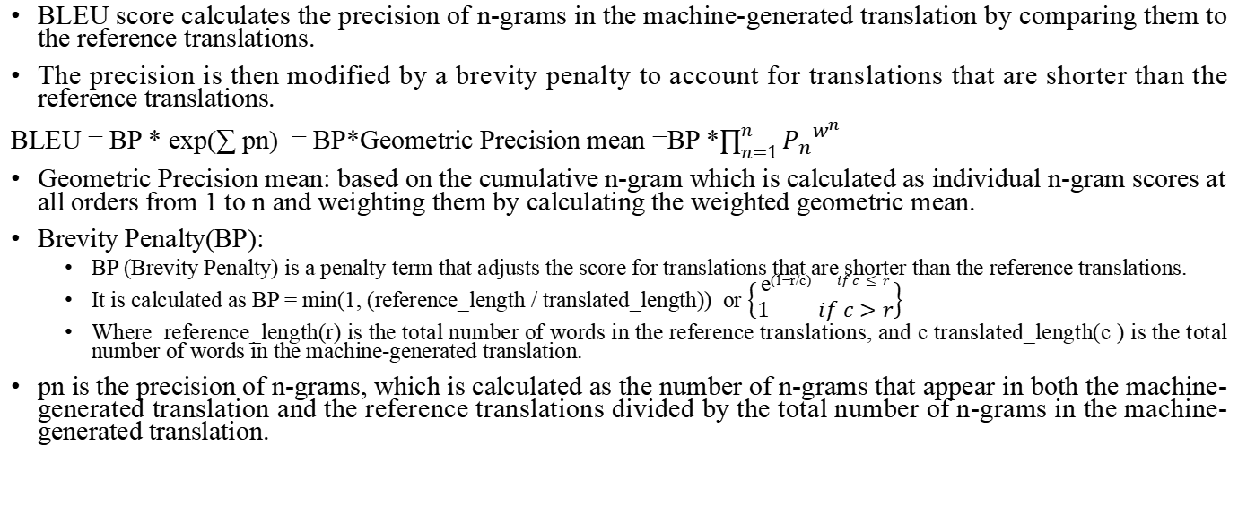
BLEU score calculates the precision of n-grams in the machine-generated translation by comparing them to the reference translations.
The precision is then modified by a brevity penalty to account for translations that are shorter than the reference translations.
BLEU = BP * exp(∑ pn) = BP*Geometric Precision mean =BP *$\prod_{n=1}^{n}{{P_{n}}^{w^{n}}}$
Geometric Precision mean: based on the cumulative n-gram which is calculated as individual n-gram scores at all orders from 1 to n and weighting them by calculating the weighted geometric mean.
Brevity Penalty(BP):
BP (Brevity Penalty) is a penalty term that adjusts the score for translations that are shorter than the reference translations.
It is calculated as BP = min(1, (reference_length / translated_length)) or $\left\{\begin{matrix}\text{e}\text{(}\text{1}\text{−}\text{r}\text{/}\text{c}\text{)} if c≤r \\ 1 if c>r\end{matrix}\right\}$
Where reference_length(r) is the total number of words in the reference translations, and c translated_length(c ) is the total number of words in the machine-generated translation.
pn is the precision of n-grams, which is calculated as the number of n-grams that appear in both the machine-generated translation and the reference translations divided by the total number of n-grams in the machine-generated translation.

Slide 32
Example
Reference 1: are you ready ?
Candidate: you are ready?

Slide 33
BLEU scoring Advantage
Quick and inexpensive to compute
Easy to understand
Language independent
Correlates highly with human evaluation
Widely adapted because of simplicity.

Slide 34
BLEU scoring limitations
It does not take into account synonymous words.
The comparison is made-up regardless of word order.
It does not take into consideration the proper use of grammar.

Slide 35
METEOR (Metric for Evaluation of Translation with Explicit ORdering)
It is a metric for the evaluation of machine translation output.
The metric is based on the harmonic mean of unigram precision and recall, with recall weighted higher than precision.
This metric includes several features such as stemming and synonymy matching, along with the standard exact word matching which are not found in any other metric.
It is designed to fix some of the problems found in the more popular BLEU metric, and also produce good correlation with human judgement at the sentence or segment level.

Slide 36
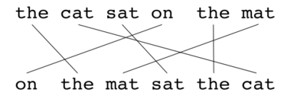
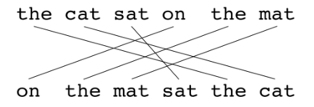
The algorithm first creates an alignment between two sentences, the candidate translation string, and the reference translation string.
The alignment is a set of mappings between unigrams.
A mapping can be thought of as a line between a unigram in one string, and a unigram in another string.
There is a constraints that every unigram in the candidate translation must map to zero or one unigram in the reference
If there are two alignments with the same number of mappings, the alignment is chosen with the fewest crosses, that is, with fewer intersections of two mappings.
From the two alignments shown, alignment (a) would be selected at this point
Alignment (a)
Alignment (b)

Slide 37


Once the final alignment is computed, the score is computed as follows:
Unigram precision P :
Where m is the number of unigrams in the candidate translation that are also found in the reference translation, and
𝑤_{𝑡} is the number of unigrams in the candidate translation.
Unigram Recall R:
Where m is defined as above and
𝑤_{r} is the number of unigrams in the reference translation.

Slide 38

Precision and recall are combined using the harmonic mean in the following fashion, with recall weighted 9 times more than precision:
This measure work with respect to single words but not with respect to larger segments that appear in both the reference and the candidate sentence.
To resolve this, longer n-gram matches are used to compute a penalty p for the alignment.
The more mappings there are that are not adjacent in the reference and the candidate sentence, the higher the penalty will be.
To compute this penalty, unigrams are grouped into the fewest possible chunks.
Chunk is defined as a set of unigrams that are adjacent in the hypothesis and in the reference.
The longer the adjacent mappings between the candidate and the reference, the fewer chunks there are.
A translation that is identical to the reference will give just one chunk.

Slide 39

The penalty p is computed as follows,
Where c is the number of chunks, and
𝑢_{m} is the number of unigrams that have been mapped i.e. number of unigram in hypothesis or candidate translation are mapped.
The final score for a segment is calculated as
To calculate a score over a whole corpus, or collection of segments, the aggregate values for P, R and p are taken and then combined using the same formula.
The algorithm also works for comparing a candidate translation against more than one reference translations. In this case the algorithm compares the candidate against each of the references and selects the highest score.
The penalty has the effect of reducing the 𝐹_{mean} by up to 50% if there are no bigram or longer matches.

Slide 40
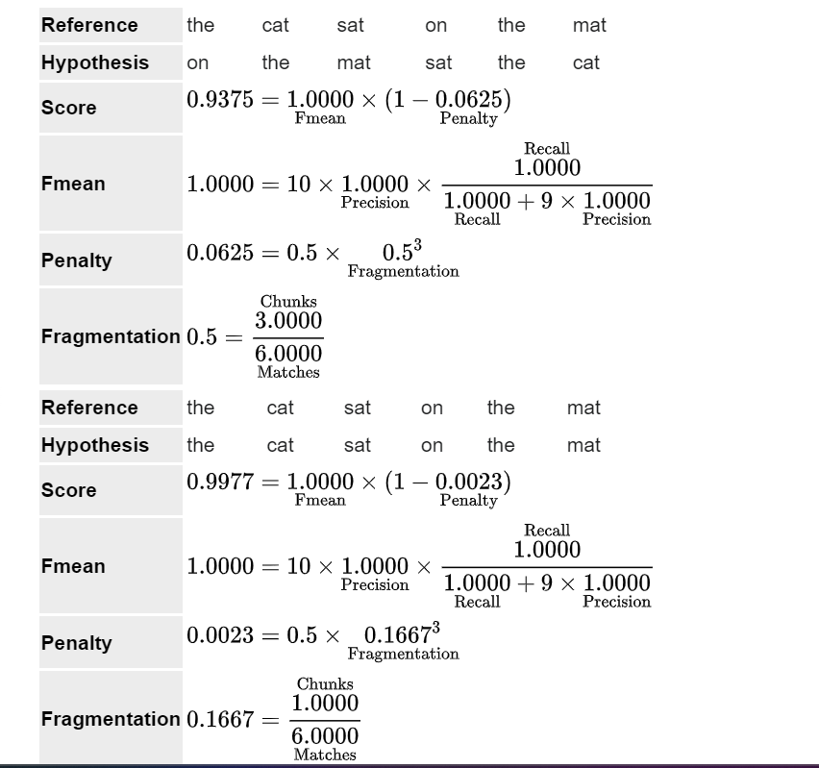
Example

Slide 41
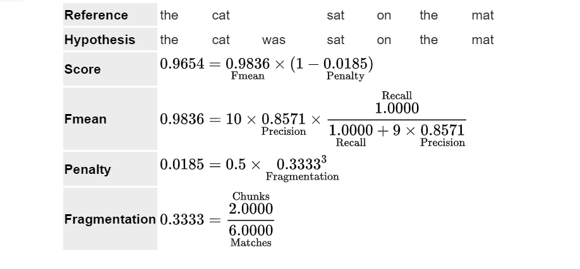

Slide 42
ROUGE- Recall-Oriented Understudy for Gisting Evaluation
It is a set of metrics and a software package used for evaluating automatic summarization and machine translation software in natural language processing.
The metrics compare an automatically produced summary or translation against a reference or a set of references (human-produced) summary or translation.
ROUGE metrics range between 0 and 1, with higher scores indicating higher similarity between the automatically produced summary and the reference.

Slide 43
The following five evaluation metrics are available.
ROUGE-N: Overlap of n-grams[2] between the system and reference summaries.
ROUGE-1 refers to the overlap of unigrams (each word) between the system and reference summaries.
ROUGE-2 refers to the overlap of bigrams between the system and reference summaries.
ROUGE-L: Longest Common Subsequence (LCS) based statistics.
Longest common subsequence problem takes into account sentence-level structure similarity naturally and identifies longest co-occurring in sequence n-grams automatically.
ROUGE-W: Weighted LCS-based statistics that favors consecutive LCSes.
ROUGE-S: Skip-bigram based co-occurrence statistics.
Skip-bigram is any pair of words in their sentence order.
ROUGE-SU: Skip-bigram plus unigram-based co-occurrence statistics.

Slide 44
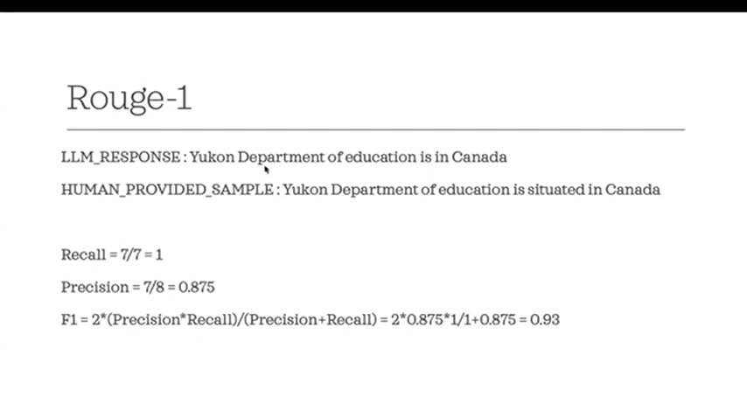


Slide 45
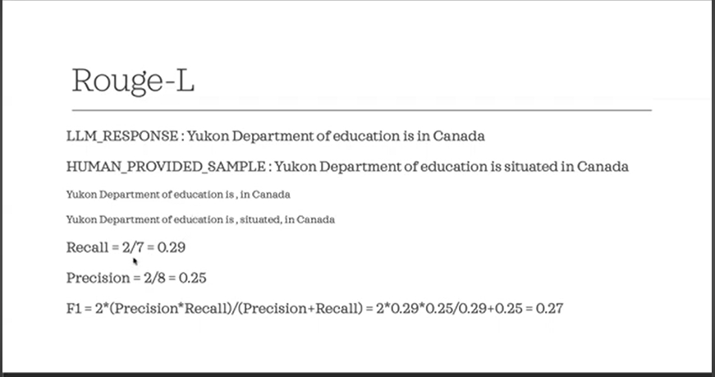

Slide 46
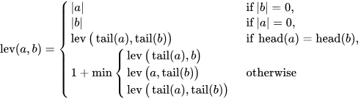
Word Error Rate (WER)
It is a common metric of the performance of a speech recognition or machine translation system.
In MT, recognized word sequence can have a different length from the reference word sequence.
The WER is derived from the Levenshtein distance, working at the word level instead of the phoneme level.
The Levenshtein distance between two strings 𝑎 and 𝑏} (of length |𝑎| and |b|} respectively) is given by lev(𝑎,𝑏)
Where

